Slide 1
Taux d’ISO lors d’une chirurgie rachidienne
J. Lebhar
P. Kriegel

Slide 2
Plan
Chirurgie conventionnelle
Chirurgie mini-invasive
Vancomycine in-situ

Slide 3
Chirurgie conventionnelle

Slide 4
Rates of Infection After Spine Surgery Based on 108,419 Procedures. A Report from the Scoliosis Research Society Morbidity and Mortality Committee Smith JS. Spine. 2011;36:556-563
The SRS M&M database
108 419 surgical cases
The overall rates of superﬁcial and deep infection were 0.8% and 1.3%, respectively -> 2,1%
Procedures using a minimally invasive approach comprised 13% of cases.
Notes:
Base de donnée de 2004 à 2007
La + générale des études

Slide 5
Facteurs de risque
Reprise 3.3% vs 2.0% (p<0.001)
Arthrodèse 2.4% vs 1.8% (p<0.001)
Déformation 3.7% vs Dégénératif 1.4%
Voie postérieure (2,3-3,2%) vs Voie antérieure 0.6%
Voie combinée antéro-postérieur 3.2%,
PLF 3.0%,
TLIF/PLIF 2.3%
Ciel ouvert 2.4% vs mini-invasive* 0.5% (p<0.001)
*Dissectomie (0.4 vs 1.1) et TLIF (1.3 vs 2.9)

Slide 6
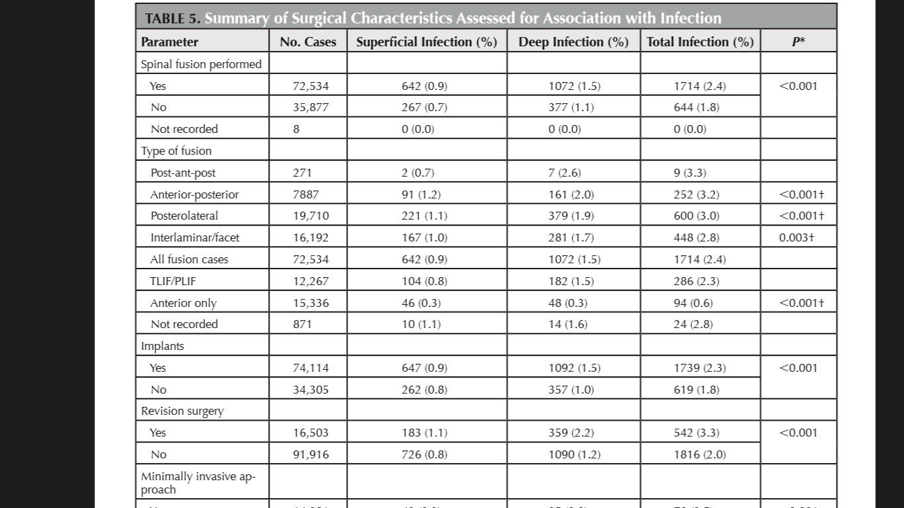

Slide 7
- 15069 premières intentions
- 605 reprises
Infections profondes : 1,9% en 1ère intention vs 4,5% en révision
Notes:
Plus grande cohorte patients instrumenté
Infections profondes : 1.9% in primary and 4.5% in revisions

Slide 8
Complications related to instrumentation in spine surgery: a prospective analysis Peter G. CamPbell. Neurosurgical focus. 2011;31:E10.
Etude prospective (mai-déc 2008)
248 patients inclus, 202 arthrodèses
56 % de complications
Suivi des complications jusqu’à J30
Complication majeure la plus fréquente: ISO
Notes:
Série prospective de mai à déc 2008
202 Avec instrumentation

Slide 9
Notes:
FdR de cette étude

Slide 10
The Inﬂuence of Perioperative Risk Factors and Therapeutic Interventions on Infection Rates After Spine Surgery A Systematic Review Schuster JM. Spine. 2010;35:S125-S137
For our ﬁrst question, we identiﬁed all articles evaluating preoperative and intraoperative risk factors for early (3 months from discharge SSI occurring as a result of primary spine surgery
Articles were excluded if they were pediatric studies (age 18 years), tumor surgery, revision surgery, treatment for osteomyelitis, other than spine surgery, or evaluating antibiotics.
From the included articles, the following data were extracted : patient demographics, diagnosis, spine surgical intervention, risk factors evaluated, wound care measures, infection rates, and results
Notes:
Méta analyse
ISO sur Chirurgie rachidienne de 1ere intention uniquement
Articles de 1990 à 2009
19 articles retenus

Slide 11
Notes:
Revue sur 19 articles

Slide 12
Results
Surgical-site infection rates ranged from < 1% to 10.9%.
12 of the 19 studies reviewed reported a surgical-site infection rate < 5%. The remaining 7 were between 5% and 11%.
Preoperative and intraoperative risk factors that were reported in 3 or more studies.
Notes:
12 études avec moins de 5% d’infections
7 entre 5 et 11

Slide 13
Age
Age: Seven case-control studies evaluated age as a preoperative risk factor for postoperative surgical-site infection.
In the only study that reported an OR as an effect measure for the association between age and postoperative infection, patients aged > 60 years were nearly 3 times more likely to develop a postoperative surgical-site infection compared with those 60 years and younger (OR=2.7; 95% conﬁdence interval [CI], 1.2–6.3; P 0.03).
In 3 additional studies, the mean ages of the cases were appreciably greater than the controls (p=0.06, 0.001, 0.04, respectively), with cases having a mean age near or above 60 years of age and controls with a mean age < to 60 years.
In the remaining 3 studies, mean ages were similar between cases and controls.
Notes:
Patients âgés de plus de 60 ans
1 étude avec un OR significatif
Les autres tendance mais pas significatif
Difficile de conclure pour 60 ans -> Plus vieux??

Slide 14
Diabète
Diabete: Seven case-control studies and 1 retrospective cohort study evaluated diabetes.
Five of these studies reported a statistically signiﬁcant association between diabetes and postoperative surgical-site infection (p=0.005, 0.04, 0.02, 0.001, 0.02, respectively).
Corresponding ORs were 4.2 (95% CI, 1.1–16.3), 4.0 (95% CI, 1.2–12.8), 6.3 (95% CI, 3.3– 12.1), and 3.5 (95% CI, 1.2–10.0).
Notes:
5 études avec OR significatif

Slide 15
BMI
BMI : Six case-control studies evaluated body mass index (BMI)/obesity as a preoperative risk factor for postoperative surgical-site infection.
Obesity was deﬁned by different cut off levels for BMI ranging from 25.5 to 35 kg/m.
Five of the 6 studies reported a statistically signiﬁcant association between obesity and postoperative surgical-site infection. ORs ranged from 2.2 to 7.1.
Notes:
5 études avec OR significatif

Slide 16
Durée de chirurgie
Duration of Surgery: Seven case-control studies evaluated duration of surgery
Only 2 case-control studies reported a statistically signiﬁcant association (long duration deﬁned by >75th percentile of all subjects) OR = 4.7, 95% CI, 1.6–14.0; p<0.001 and OR = 2.4, 95% CI, 1.2–4.6; p=0.012
The article by Apisarnthanarak et al reported an OR of 3.4 (0.95–12.1; p=0.08) for a duration of > 3hours.
However, 6 of 7studies demonstrated a greater rate of infection in longer cases than in controls; therefore, we cannot rule out a possible association.
Notes:
2 études avec OR significatif au 75eme percentile
1 pour une durée de plus de 3h

Slide 17
Abord Postérieur
Posterior Approach : Three case-control studies evaluated a posterior approach, with all 3 reporting a statistically signiﬁcant association between posterior approach and postoperative surgical-site infection. ORs were 3.5(95%CI,1.2–9.7;P=0.02),8.2(95%CI,2.0–33.5; P = 0.003), and 3.4 (95% CI, 1.2–9.8; P = 0.02), respectively.
Notes:
3 études avec OR significatif

Slide 18
Score ASA
ASA Score: Five case-control studies evaluated the preoperative ASA score as a risk factor
A high ASA score was deﬁned as a score of 3 or greater.
Four of the 5 studies reported a statistically signiﬁcant association between high ASA scores and postoperative surgical-site infection. ORs ranged from 2.6 to 9.7.
Notes:
4 études avec OR significatif

Slide 19
Intraoperative Fraction of Inspired Oxygen Is a Modiﬁable Risk Factor for Surgical Site Infection after Spinal Surgery Maragakis. Anesthesiology. 2009;110;556-562
Retrospective study (2001-2004) : laminectomy, fusion or both.
Cases and controls were not matched on any criteria, controls were randomly selected
Surgeons in the Departments of Neurosurgery and Orthopedics perform approximately 1 100 laminectomy and spinal fusion procedures each year
RESULTS
During the study period, 3,894 laminectomy and spinal fusion procedures were performed at our institution. One hundred four patients developed SSI, for an overall infection rate of 2.67 per 100
Fifty-three (51%) of the infections were classiﬁed as deep incisional, 10 (10%) as organ space, and 41 (39%) as superﬁcial incisional
Notes:
Etude retrospective,
Taux d’infection de 2,67% sur environ 4000 patients

Slide 20
Tabac, diabète résultats non significatifs

Slide 21
Shaving with a razor before surgery is a well-documented risk factor for SSI, and guidelines from the CDC Healthcare Infection Control Practices Advisory Committee recommend avoidance of hair removal before surgery when possible and the use of clippers if hair removal is necessary.
Despite this, we were surprised to ﬁnd that 20% of study patients were shaved with a razor before spinal surgery, and this was a signiﬁcant, independent risk factor for SSI.
Notes:
Attention au Rasage

Slide 22
Complications and Risk Factors of Primary Adult Scoliosis Surgery A Multicenter Study of 306 Patients Charosky S. Spine. 2012;37:693–700
French Study (GES)
Between 2002 and 2007
Incidence of complications on primary adult scoliosis patients ( > 50 yrs)
306 patients
SSI : 5,2 %.
All thepatients who presented with an infectious complication were treated surgically.

Slide 23
Au total, les FdR
Age
BMI
Diabète
Score ASA
Durée de la chirurgie
Abord postérieur
Déformation (scoliose) -> nb de niveaux

Slide 24
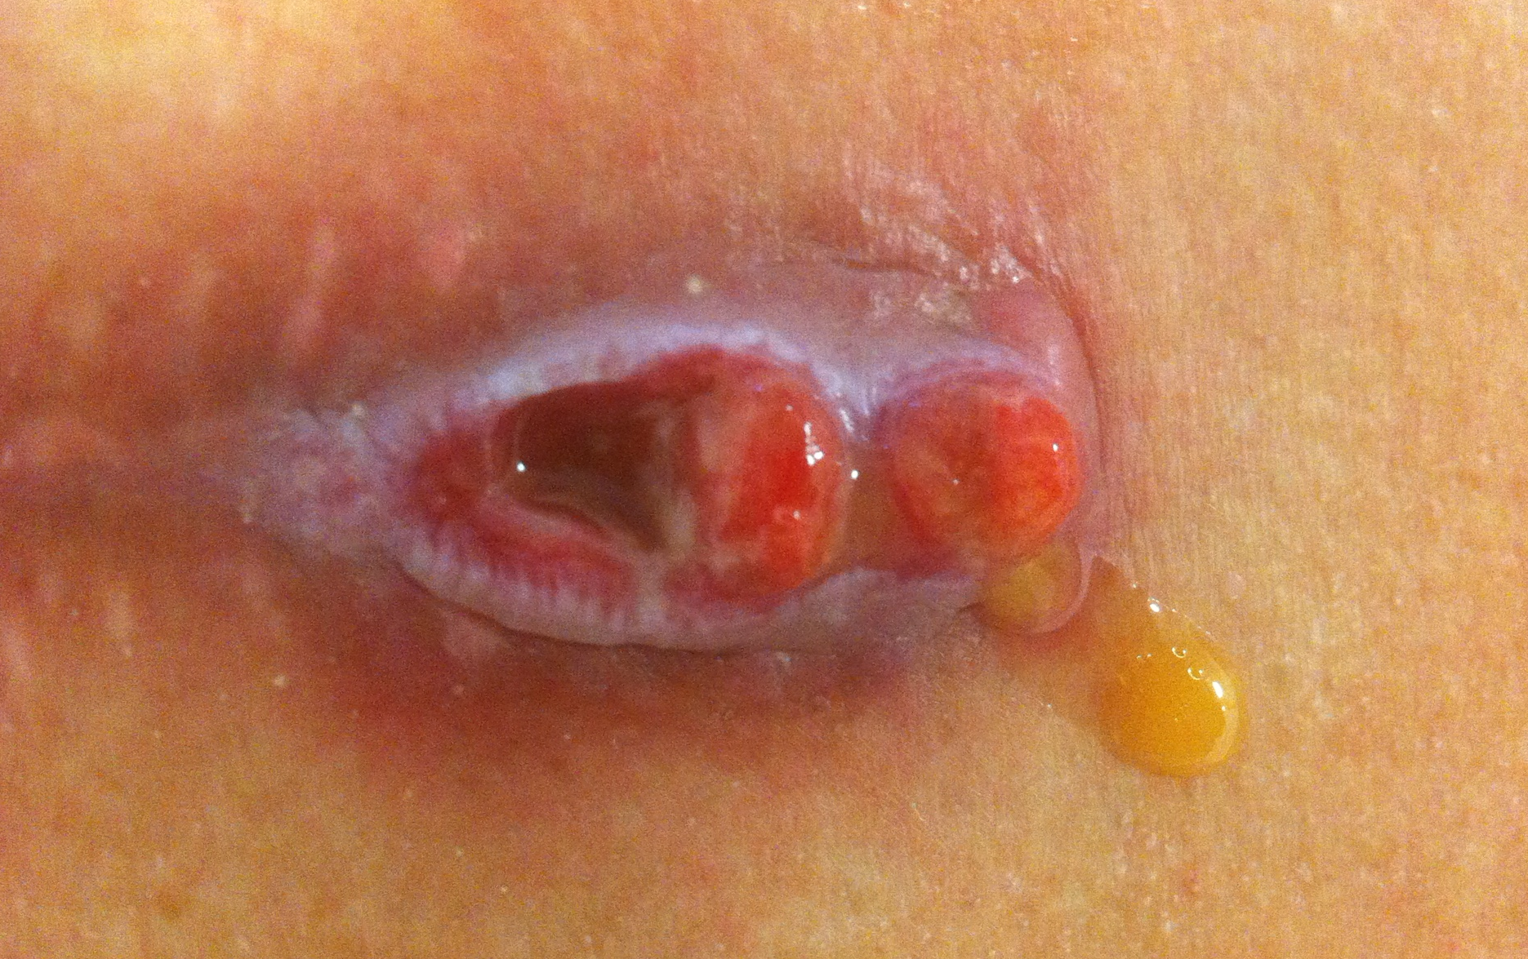
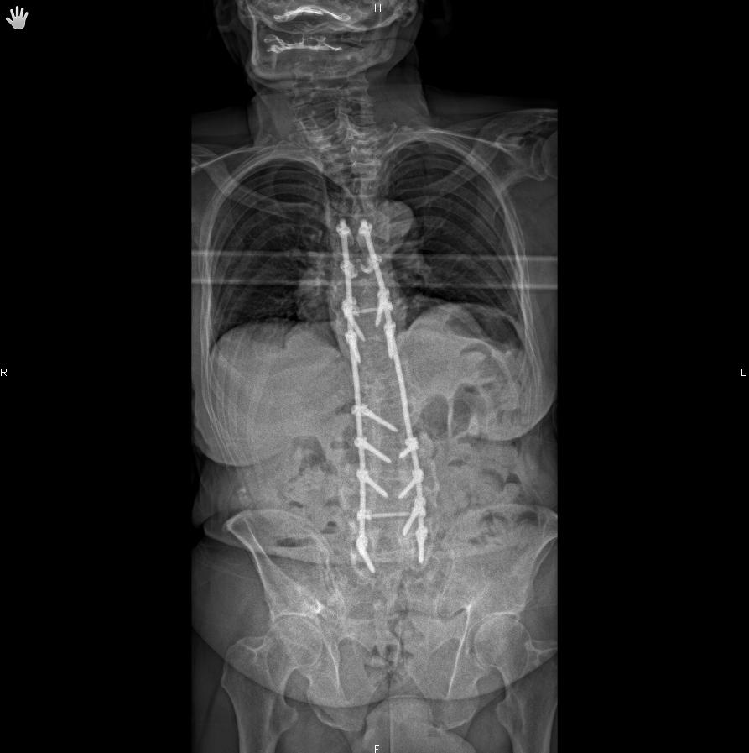
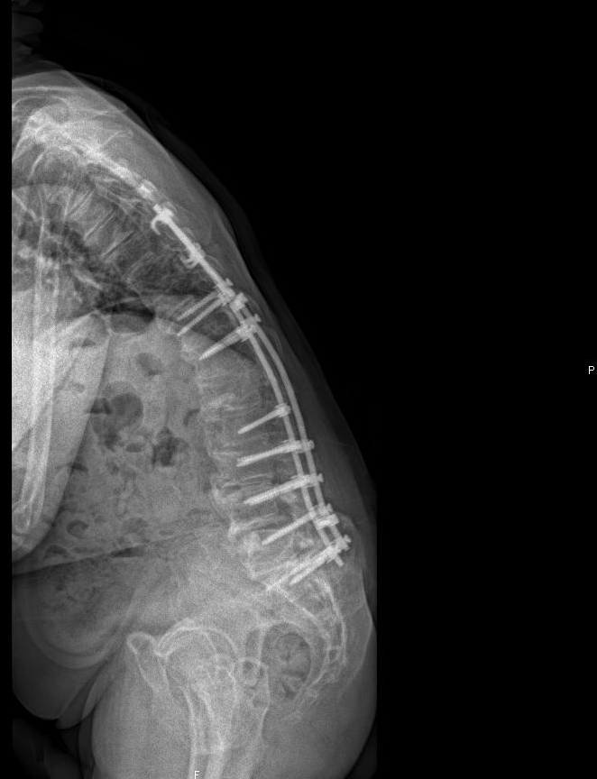
73 ans
ASA 3
BMI > 25 kg/m²
Plusieurs niveaux
Abord postérieur
Reprise

Slide 25
Chirurgie mini-invasive

Slide 26
Surgical site infection rates after minimally invasive spinal surgery. O‘Tool JE. J Neurosurg Spine . 2009;11:471-476
Retrospective review, over an almost 8-year period (February 2000 to December 2007) performed by 3 surgeons at 4 different institutions.
Minimally invasive spinal surgery cases were defined as any spinal surgery performed through a tubular retractor–type systeme
The procedures performed included simple decompressive procedures such as MED/F or decompression of stenosis, as well as minimally invasive arthrodeses (including posterolateral, posterior/transforaminal interbody, and lateral interbody) with percutaneous instrumentation, and minimally invasive intradural procedures for tumors, filum detethering, or syrinx shunting
All patients received a single dose of intravenous antibiotics immediately preoperatively (1–2 g cefazolin or 1-g vancomycin in patients reporting a penicillin or cephalosporin allergy), which was repeated as needed during surgeries lasting longer than 4 hours.
MED/F = micro- or endoscopic discectomy or foraminotomy; MEDS = micro- or endoscopic decompression of stenosis;
Notes:
Rétrospective
2000-2007
Chirurge de décompression, arthrodèses et tumeurs intradurales

Slide 27
RESULTS
1338 MISSs in 1274 patients. Age was 55.5 years (range 18–97 years).
The average length of follow-up for the series was 7.8 months (range 3–49 months).
The mean operative times for each of the procedural subgroups was as follows: MED/F 101 minutes; MEDS 118 minutes; minimally invasive fusion 228 minutes and minimally invasive intradural surgeries 186 minutes.
The mean number of levels fused per minimally invasive fusion case was 1.26.
We detected a very low rate of SSIs in this large series of patients who underwent MISS. The postoperative infection rates of 0.74% for instrumented arthrodesis and 0.22% for the entire cohort are some of the lowest ever reported for a series of this size.
Notes:
Chirurgie Lombaire
1338 interventions
Mais 60% de HD
20% de Fusion

Slide 28
Notes:
MIS vs ciel ouvert pour arthrodèse uniqement
Non significatif pour chir 1 étage mais significatif pour 2 étages

Slide 29
Comparison of One-Level Posterior Lumbar Interbody Fusion Performed With a Minimally Invasive Approach or a Traditional Open Approach Park Y. Spine. 2007;32:537-543
Etude prospective, Voie postérieure VS mini invasif
Minimally invasive PLIF, Using the Sextant
Open PLIF group, after skin incision about 14 cm
Suivi minimum de 1 an
Notes:
Au Final, Indictions différentes sur Open vs MIS…

Slide 30
Au total, pour la MIS
Etudes très différentes méthodologiquement les unes des autres
Difficile de conclure
Tendance à un moindre taux d’ISO

Slide 31
Vancomycine in-situ

Slide 32
Intrawound Application of Vancomycin for Prophylaxis in Instrumented Thoracolumbar Fusions Efﬁcacy, Drug Levels, and Patient Outcomes Sweet FA. Spine. 2011;36:2084-2088.
Betadine prep
2 g of IV cefazolin given within an hour before incision and continued for 24 hours.
A total of 2 g of vancomycin powder was applied directly to the surgical wound during closure.
Approximately 1 g of vancomycin powder was mixed in with the bone grafting material a minimum of 15 minutes before placement in the wound.
One hundred seventy-eight consecutive patients from the vancomycin group had blood samples obtained from the wounds via the surgical drains on postoperative day 0 to 3 with simultaneous serum levels to determine vancomycin concentrations.
Notes:
Prophylaxie à la vancomycine en poudre dans le site opératoire
2 g soupoudrer
1 g mélanger à la greffe
Concentration de vanco dans les drains et dans le sang

Slide 33
Superﬁcial wound complications and infection that did not require surgical debridement or IV antibiotics were not further analyzed.
Notes:
Analyse uniquement des infections profondes
Présentation des 2 pop

Slide 34
Results
The difference in infection rates between the adjunctive vancomycin group (0.2%) and control group (2.6%) was statistically signiﬁcant (p< 0.0001).
There was no signiﬁcant difference between the control and vancomycin groups for pre operative ODI (p=0.38), postoperative ODI (p= 0.67), preoperative SF-36 (P=0.42), or postoperative SF-36 (p=0.54).
Vancomycin powder cost per patient is approximately $12

Slide 35
Vancomycin from the surgical drains peaked on postoperative with an average of 1475 μg/mL (263–2938) on day 0 and dropped to an average of 128 μg/mL (37–311) on postoperative day 3.
Serum vancomycin levels were not detected in 80% of patients with a minimum sensitivity of 0.6 μg/mL.
In 20% of patients where a serum vancomycin drug level was detected, the average vancomycin level was 1.6 μg/ mL (0.7 to 5.9) on post operative day 1. Only 6% of patients had detectable vancomycin blood levels after post operative day 1.
Notes:
Taux de vanco dans les drains
80% des patients avec une vancocynémie à 0

Slide 36
Prophylactic intraoperative powdered vancomycin and postoperative deep spinal wound infection: 1,512 consecutive surgical cases over a 6-year period Molinari RW. Eur Spine J. 2012;21:S476-S482.
1 g vancomycin powder was placed into each wound at the conclusion of each procedure and prior to closure of the deep lumbar fascia.
Receive a perioperative dose of IV antibiotic within 60 min of the surgical incision for routine infection prophylaxis. One gram of cefazolin was administered.
Only the rate of deep spinal surgical wound infection was determined.

Slide 38
Results
849 cases were uninstrumented, 478 cases were instrumented posterior thoracic or lumbar, 12 instrumented anterior thoracic or lumbar, 126 instrumented anterior cervical, 47 instrumented posterior cervical
Total of 1512 cases.
15 of the 1,512 patients (0.99%) as having evidence of postoperative deep wound infection
1.20% (8/663) for instrumented spinal surgeries, and 0.82% (7/849) for posterior decompressive laminectomy

Slide 39
Increased rates of complications related to powdered vancomycin use were not identiﬁed in this series.
A search of the medical records and surgical database did not reveal evidence of increased rates of postoperative renal insufﬁciency or renal failure among the 1,512 consecutive spinal surgical cases, and only one patient (0.07%) was identiﬁed as having unexplained renal failure or insufﬁciency after elective spinal surgery.
Two additional patients (0.13%) experienced transient hearing loss that resolved in the early postoperative period.
Notes:
1 cas d’insuffisance rénale et 2 cas d’ototoxicité transitoire. Non documenté…

Slide 40
Lumbar laminectomy and fusion with routine local application of vancomycin powder: Decreased infection rate in instrumented and non-instrumented cases. Strom R. Clinical and Neurosurgery. 2013;115 1766– 1769
Review board
January 2007 to December 2011
All patients received intravenous antibiotics within 1h of skin incision
Routine local application of 1 g vancomycin powder was started in August 2009
It was not applied to the instrumentation or bone graft
Subfascial drains were placed in all patients
Intravenous antibiotics were continued while the drains were in place
Notes:
2 gpes comparatifs

Slide 41
Patients were divided into two groups:
those who had surgery without vancomycin powder (January 2007–July 2009)
Those who received vancomycin powder (August 2009–December 2011)
Minor superficial wound issues such as stitch abscesses and transient erythema were not recorded as infections.
Medical records were searched for cases of postoperative acute renal failure, hearing loss, and any other systemic complications attributed to vancomycin powder
Notes:
1 g de vanco en poudre + drain
Pas d’application sur greffe ms sur tissues mou
Vanco + drain compatible

Slide 42
Notes:
Attention : gpe non tté, plus d’instrumenter que ds gpe vanco

Slide 43
There were no cases of nephrotoxicity, ototoxicity, or other systemic complications from vancomycin powder.
This study has several limitations. It is a retrospective review of a single surgeon’s cases at a single medical center.
One potential weakness of this study is the small size of some of the subgroups. There were 20 patients who underwent non-instrumented fusion prior to the introduction of vancomycin powder
Notes:
Pas de complication rénale ou ototoxique
Mais des gpe différents et un manque de données...

Slide 44
Notes:
Arthrodèse post dans la chirurgie rachidienne traumatique

Slide 45
Notes:
1 g de vanco en poudre
Pas sur la greffe
Avec un drain

Slide 46
Notes:
Gpes similaires

Slide 47
Notes:
Durée opératoire plus longue dans gpe contrôle
7 vs 0

Slide 48
Effect of cefazolin and vancomycin on osteoblasts in vitro.
Edin ML. Clin Orthop Relat Res. 1996
The effect of cefazolin and vancomycin on osteoblast-like cells was studied.
Cells from the MG-63 human osteosarcoma cell line were grown in antibiotic free media and exposed to concentrations of cefazolin and vancomycin ,intervals between 0 and 10,000 microg/ml.
Cell number and 3H-thymidine incorporation at 0, 24, and 72 hours were determined.
The results of this study show that local levels of vancomycin of 1000 microg/ml and less have little or no effect on osteoblast replication, and concentrations of 10,000 microg/ml cause cell death.
Notes:
Effet de la cefazo et vanco sur ostéoblaste
< 100 microg/mL pas d’effet
>10000 apoptose
Tableau de l’étude n°1 pour comparer le taux de vanco dans les drains au taux d’apoptose

Slide 49
Conclusion
Chirurgie à ciel ouvert
Taux d’ISO très variable (1,2 à 10,9%)
FdR liés aux patients : Age (>60), BMI (>25), ASA(> 3), DNID
FdR liés à l’intervention : Reprises, Déformations (scolioses), Arthrodèse, Nb d’étages >/= 2, Voie post, durée opératoire
Voie antérieure très attractive
Sélection des patients ?
Information des patients et entourage +++
Chirurgie mini-invasive
Encore peu pratiquée
Tendance à une réduction du taux d’ISO
Piste à explorer ?
Intérêt de la vancomycine in-situ ?
Tendance à une réduction du taux d’ISO
Pas de nocivité démontrée

