Slide 1
Soirée de bibliographie du CRIOGO
21 mars 2018
Bibliographie générale – Dr Cédric Arvieux

Slide 2
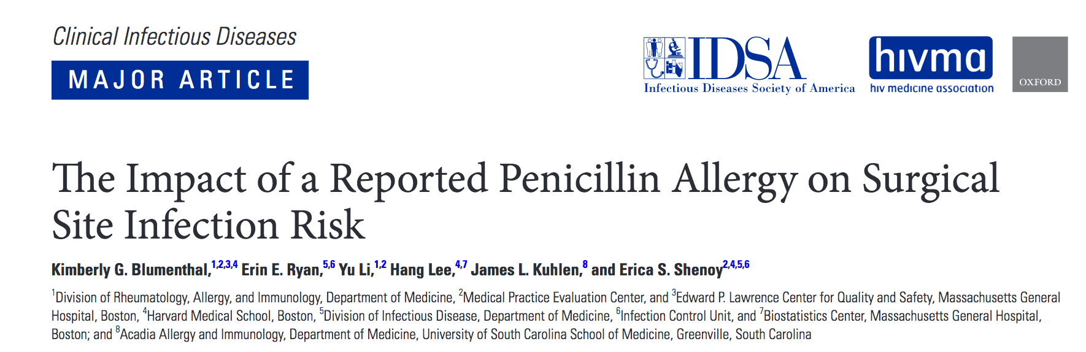
2010-2014
9004 chirurgies pour 8385 patients, dont 922 (11%) »allergiques » à la pénicilline
241 infections de sites opératoires (2,7%)
Les patients rapportant une histoire d’allergie à la pénicilline ont 50% de majoration de risque de faire une infection de site opératoire (OR : 1,51 IC₉₅ 1,02-2,20)
Notes:
Abstract
Background
A reported penicillin allergy may compromise receipt of recommended antibiotic prophylaxis intended to prevent surgical site infections (SSIs). Most patients with a reported penicillin allergy are not allergic. We determined the impact of a reported penicillin allergy on the development of SSIs.
Methods
In this retrospective cohort study of Massachusetts General Hospital hip arthroplasty, knee arthroplasty, hysterectomy, colon surgery, and coronary artery bypass grafting patients from 2010 to 2014, we compared patients with and without a reported penicillin allergy. The primary outcome was an SSI, as defined by the Centers for Disease Control and Prevention’s National Healthcare Safety Network. The secondary outcome was perioperative antibiotic use.
Results
Of 8385 patients who underwent 9004 procedures, 922 (11%) reported a penicillin allergy, and 241 (2.7%) had an SSI. In multivariable logistic regression, patients reporting a penicillin allergy had increased odds (adjusted odds ratio, 1.51; 95% confidence interval, 1.02–2.22) of SSI. Penicillin allergy reporters were administered less cefazolin (12% vs 92%; P < .001) and more clindamycin (49% vs 3%; P < .001), vancomycin (35% vs 3%; P < .001), and gentamicin (24% vs 3%; P < .001) compared with those without a reported penicillin allergy. The increased SSI risk was entirely mediated by the patients’ receipt of an alternative perioperative antibiotic; between 112 and 124 patients with reported penicillin allergy would need allergy evaluation to prevent 1 SSI.
Conclusions
Patients with a reported penicillin allergy had a 50% increased odds of SSI, attributable to the receipt of second-line perioperative antibiotics. Clarification of penicillin allergies as part of routine preoperative care may decrease SSI risk.

Slide 3
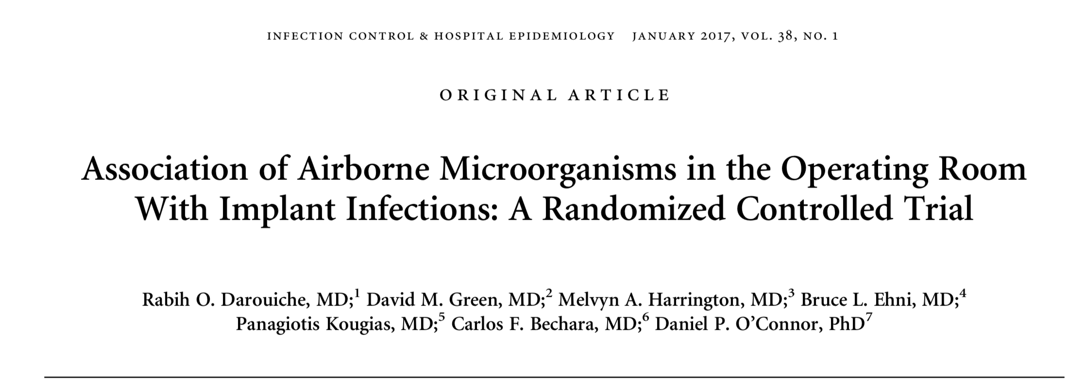
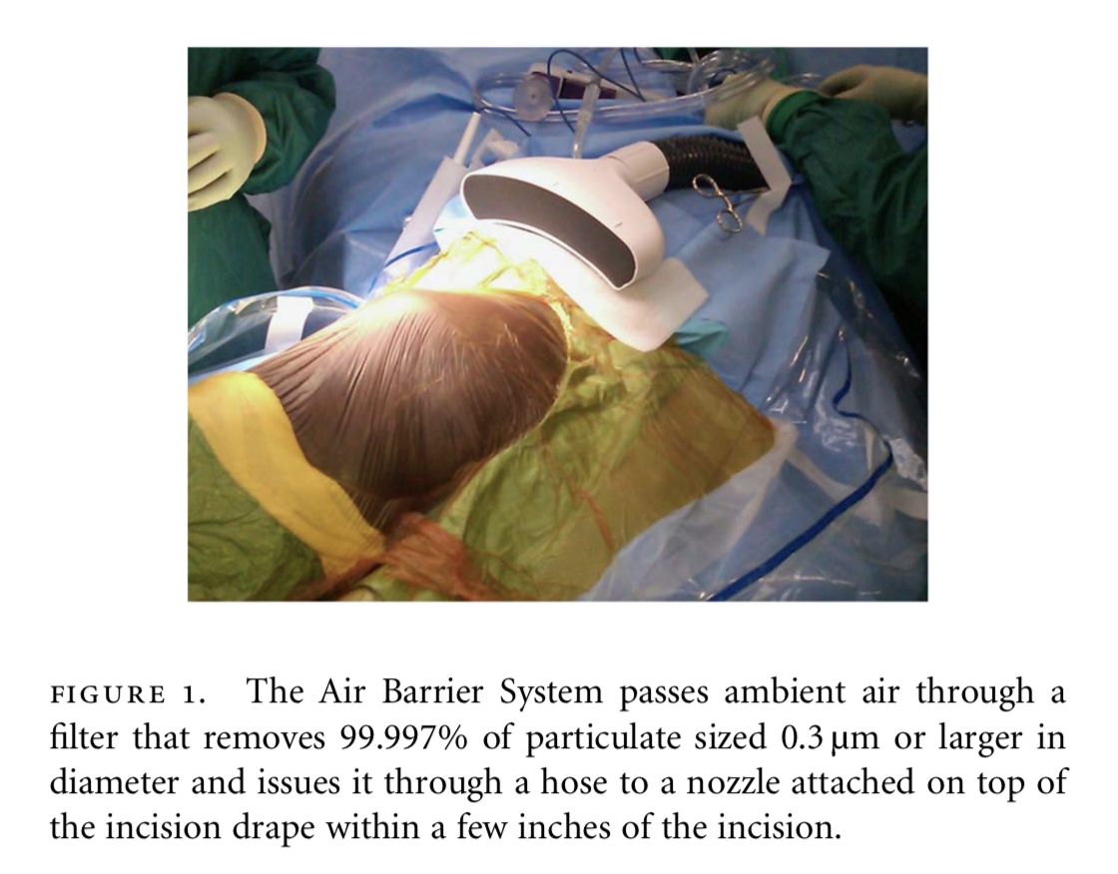
Essai randomisé
300 patients (prothèses de hanche, matériel rachidien, prothèse vasculaires
Utilisation de « l’Air Barrier System » versus soins habituels
→ Le nombre de CFU au site opératoire est diminuée dans le groupe « ABS » (p<0,01)
→ Le nombre de CFU est prédicitif de l’infection : 4 fois plus de CFU dans les 4 infections de prothèses rapportées.
100% des 4 infections dans le groupe contrôle
Notes:
objective. To evaluate the association of airborne colony-forming units (CFU) at incision sites during implantation of prostheses with the incidence of either incisional or prosthesis-related surgical site infections.
design. setting. patients.
Randomized, controlled trial. Primary, public institution.
Three hundred patients undergoing total hip arthroplasty, instrumented spinal procedures, or vascular bypass graft implantation.
Patients were randomly assigned in a 1:1 ratio to either the intervention group or the control group. A novel device (Air Barrier System), previously shown to reduce airborne CFU at incision sites, was utilized in the intervention group. Procedures assigned to the control group were performed without the device, under routine operating room atmospheric conditions. Patients were followed up for 12 months to determine whether airborne CFU levels at the incision sites predicted the incidence of incisional or prosthesis-related infection.
results. Data were available for 294 patients, 148 in the intervention group and 146 in the control group. CFU density at the incision site was significantly lower in the intervention group than in the control group (P < .001). The density of airborne CFU at the incision site during the procedures was significantly related to the incidence of implant infection (P = .021). Airborne CFU densities were 4 times greater in procedures with implant infection versus no implant infection. All 4 of the observed prosthesis infections occurred in the control group.
conclusion. Reduction of airborne CFU specifically at the incision site during operations may be an effective strategy to reduce prosthesis- related infections. Trial Registration: clinicaltrials.gov Identifier: NCT01610271

Slide 4
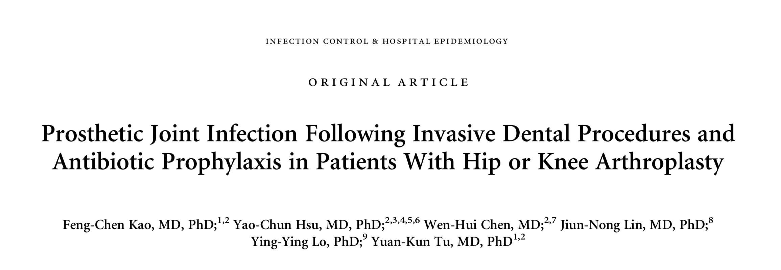
Infect Control Hosp Epidemiol 2016;1–8
Etude de cohorte retrospective, 1997 – 2009
Screening : 255 568 taiwanais ayant eu une PTG ou PTH
57 066 porteurs de prothèse ont reçu des soins dentaires, apparié 1:1 à des sujets sans procédure dentai
  Appariement secondaire sur l’antibiothéprophylaxie au cours des soins dentaires (6 513 personnes)
→ 328 patients (0.57%) ont eu une infection de prothèse dans le groupe soins dentaires versus 338 (0,61%) dans le groupe comparateur. L’incidence cumulée à un an après les soins est de 0.6% dans les deux groupes et elle n‘est pas influencée par l’antibioprophylaxie avant les soins dentaires.
Notes:
objectives. We aimed to clarify whether invasive dental treatment is associated with increased risk of prosthetic joint infection (PJI) and whether prophylactic antibiotics may lower the infection risk remain unclear.
design. Retrospective cohort study.
participants. All Taiwanese residents (N=255,568) who underwent total knee or hip arthroplasty between January 1, 1997, and November 30, 2009, were screened.
methods. The dental cohort consisted of 57,066 patients who received dental treatment and were individually matched 1:1 with the nondental cohort by age, sex, propensity score, and index date. The dental cohort was further divided by the use or nonuse of prophylactic antibiotics. The antibiotic and nonantibiotic subcohorts comprised 6,513 matched pairs.
results. PJI occurred in 328 patients (0.57%) in the dental subcohort and 348 patients (0.61%) in the nondental subcohort, with no between-cohort difference in the 1-year cumulative incidence (0.6% in both, P=.3). Multivariate-adjusted Cox regression revealed no association between dental procedures and PJI. Furthermore, PJI occurred in 13 patients (0.2%) in the antibiotic subcohort and 12 patients (0.18%) in the nonantibiotic subcohorts (P = .8). Multivariate-adjusted analyses confirmed that there was no association between the incidence of PJI and prophylactic antibiotics.
conclusions. The risk of PJI is not increased following dental procedure in patients with hip or knee replacement and is unaffected by antibiotic prophylaxis.

Slide 5
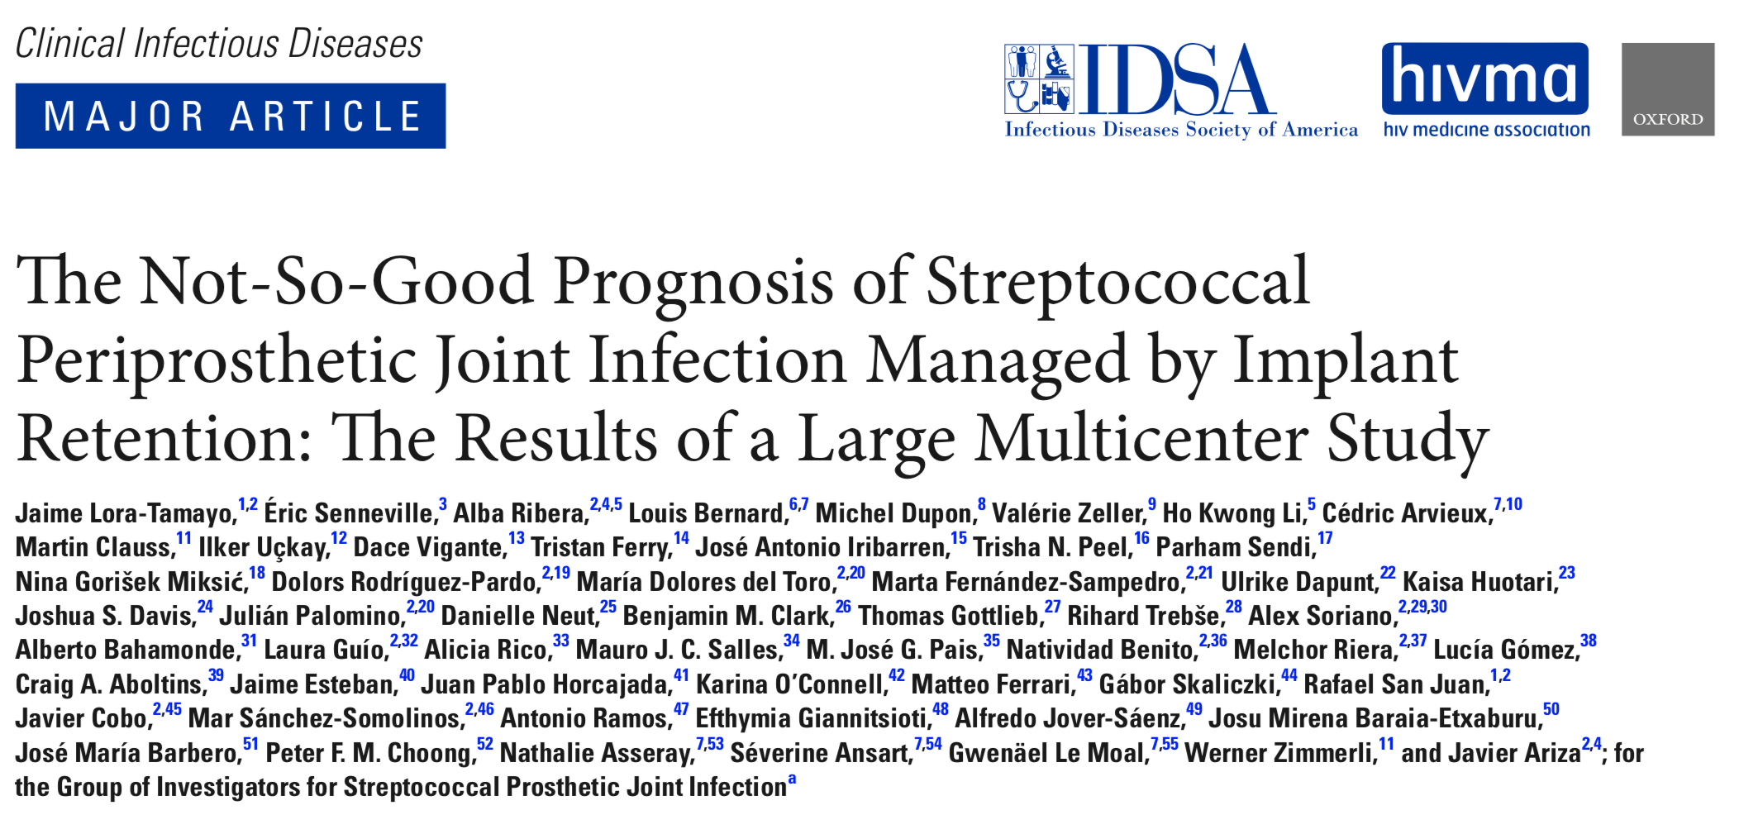
Etude de cohorte rétrospective, 2003 – 2012. Critère d’inclusion : infection de prothèse à Streptococcus traitée avec rétention de l’implant.
472 patients, Age médian 72 ans, 50% d’hommes
Strepto le + fréquent : S. agalactiae (34%), avec bactériémie fréquente.
L’évolution est évaluable pour 444 patients
  42,1% d’échec !
Facteurs de risque:
  PR (2.36)
  Infection tardive (2.20)
  Bactériémie (1.69)
Facteurs favorables
  Changement des pièces mobiles (0,6)
  Utilisation de la rifampicine (.98 par jour de traitement pendant les 30 premiers jours)
  Traitements prolongés (>21 jours) par B-lacatamines
Notes:
Background. Streptococci are not an infrequent cause of periprosthetic joint infection (PJI). Management by debridement, anti- biotics, and implant retention (DAIR) is thought to produce a good prognosis, but little is known about the real likelihood of success. Methods. A retrospective, observational, multicenter, international study was performed during 2003–2012. Eligible patients had a streptococcal PJI that was managed with DAIR. e primary endpoint was failure, de ned as death related to infection,
relapse/persistence of infection, or the need for salvage therapy.
Results. Overall, 462 cases were included (median age 72 years, 50% men). e most frequent species was Streptococcus aga-
lactiae (34%), and 52% of all cases were hematogenous. Antibiotic treatment was primarily using β-lactams, and 37% of patients received rifampin. Outcomes were evaluable in 444 patients: failure occurred in 187 (42.1%; 95% con dence interval, 37.5%–46.7%) a er a median of 62 days from debridement; patients without failure were followed up for a median of 802 days. Independent predic- tors (hazard ratios) of failure were rheumatoid arthritis (2.36), late post-surgical infection (2.20), and bacteremia (1.69). Independent predictors of success were exchange of removable components (0.60), early use of rifampin (0.98 per day of treatment within the rst 30 days), and long treatments (≥21 days) with β-lactams, either as monotherapy (0.48) or in combination with rifampin (0.34).

